Slide 1

UPS BATTERY MONITORING SYSTEM
B. Tech TARP Report
Subramanian Venkatachalam -17BEE1163
VB Yashwanth Rao -17BEE1173
Ganesh ram -17BEE1114
Thirumeni ram -17BEE1032

Slide 2
ABSTRACT
An Uninterruptible Power Supply(UPS) is an electrical apparatus that provides emergency power to a load when the input power source or main power fail.
Our UPS system will give an approximate time estimate about how long the backup power will be able to sustain the household items.
Consider that we employ a battery of 150AH capacity during power failure, a house requires 3 fans, 3 tube lights,1 CFL and 1TV. Our module measures the power available in the battery and gives the best approximation on how many devices and for how much time they can run.
The main thrust of the development work is to implement a UPS system which would be able to measure the load and give an approximate time estimate for how long the back up power would be able to sustain the household appliances.

Slide 3
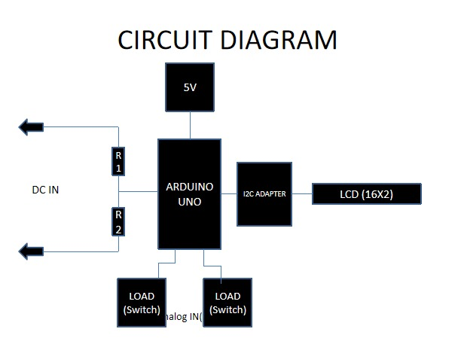

Slide 4
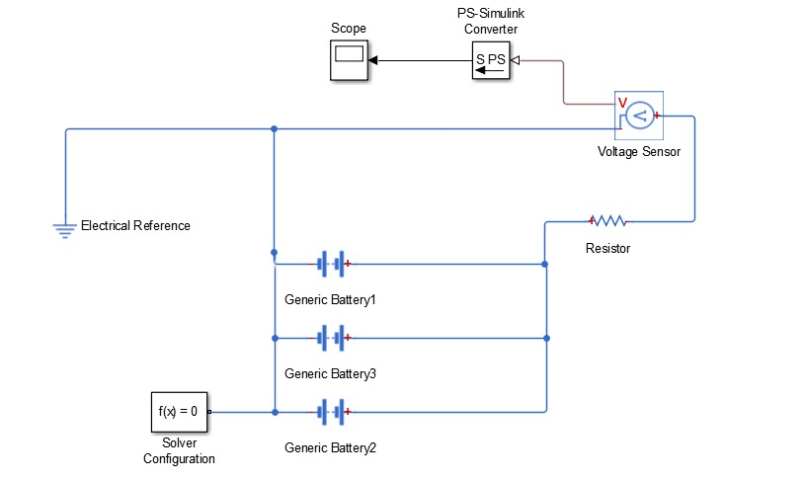

Slide 5
Components
Arduino Uno or compatible.
Male pins (we need four pins only).
Two same value resistors (here I use 12K).
Two pin female connector.
Photo shows three pin because that is what I have.
Here I use power switch connector to motherboard instead :)
A battery (I use 7.4V lipo battery).
16x2 LCD with I2C adapter.
Later on you can switch this to a red LED to indicate low battery at your desired voltage level.
A mini breadboard is optional for testing phase.

Slide 6
Working Principle of the circuit.
Arduino Uno needs 5 volts power to run, then we need at least 7.4 volts to 9 volts battery. Since Arduino pins support only 5 volts maximum, then we need a Voltage Divider. It is simply made up of two resistors in series. To divide the voltage to half, we need two resistor with the same value. 1K to 20K resistors can be used, but the larger the resistance the lower the power consumed by the Voltage Divider.

Slide 7
Current Hardware Connections

Slide 8
Previously planned Code:
/*
DC Voltmeter or Remaining charge display
An Arduino DVM based on voltage divider concept
*/
#include
LiquidCrystal lcd(7, 8, 9, 10, 11, 12);
int analogInput = 0;
float vout = 0.0;
float vin1 = 0.0;
float vin2 = 0.0;
float R1 = 100000.0; // resistance of R1 (100K)
float R2 = 10000.0; // resistance of R2 (10K)
int value = 0;
int LOAD1=0.5;
int LOAD2=0.5;
void setup(){
pinMode(analogInput, INPUT);
pinMode(6,INPUT);
pinMode(7,INPUT);
lcd.begin(16, 2);
lcd.print("DC VOLTMETER");

Slide 9
void loop(){
// read the value at analog input
value = analogRead(analogInput);
vout = (value * 5.0) / 1024.0; // see text
vin1 = vout / (R2/(R1+R2));
if (vin<0.09) {
vin1=0.0;//statement to quash undesired reading !
if(digitalRead(7)==HIGH)
{
vin2 = vin1/LOAD1;
}
else if(digitalRead(6)==HIGH)
{
vin2 = vin1/LOAD2;
}
else if(digitalRead(6)==HIGH && digitalRead(7)==HIGH)
{
vin2=vin1/LOAD1;
vin2=vin2/LOAD2;
}
lcd.setCursor(0, 1);
lcd.print("INPUT V= ");
lcd.print(vin1);
delay(500);
lcd.print("TIME REMAINING= ");
lcd.print(vin2);
}

Slide 10
Formula Used
time = (inverter efficiency * battery volt * AH)/load in watts)
The time estimate calculator is made using this formula.
We have developed a website which can take input from the users about the battery parameters, number of devices and power rating of each device, then display the total power consumption along with the time for which the UPS battery backup would last.

Slide 11
Conclusion

Slide 12
References
https://www.instructables.com/id/Arduino-Battery-Voltage-Indicator/
http://www.company7.com/library/C7_upscalc.html#:~:text=To%20determine%20the%20suitable%20UPS,AH)%2Fload%20in%20watts

